Slide 1
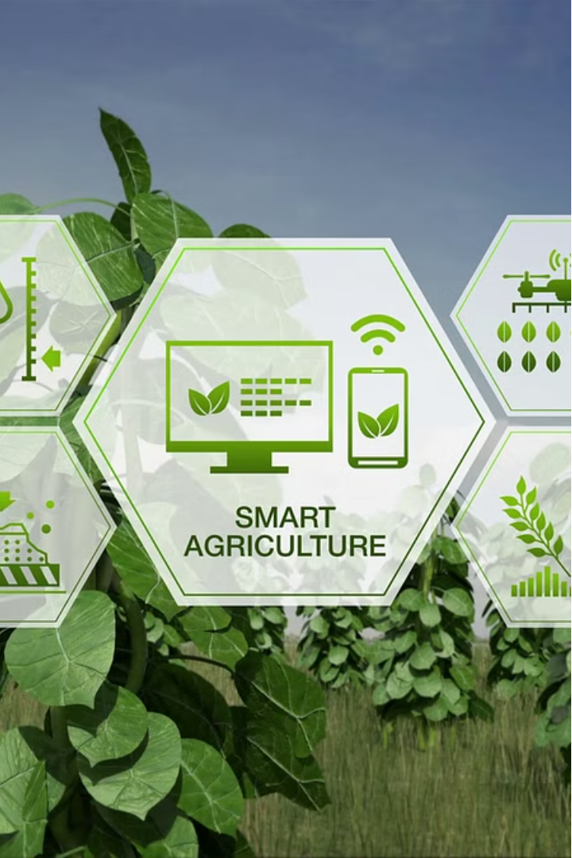



Introduction to Smart Agriculture Decision Support System
This smart agriculture decision support system empowers farmers with real-time data and intelligent insights to optimize crop production, reduce costs, and improve sustainability. It integrates cutting-edge technologies to revolutionize the way we approach modern farming.
by Venkat Ummidi

Slide 2



Data Collection and Monitoring
Sensor Networks
Satellite Imagery
Aerial Drones
Strategically placed sensors continuously monitor soil, weather, and crop conditions.
High-resolution satellite data provides a bird's-eye view of the entire farmland.
Drones equipped with cameras and multispectral sensors gather precise field-level insights.

Slide 3
Soil and Crop Analysis
Soil Health Assessment
Crop Monitoring
Predictive Analytics
Computer vision techniques analyze plant health, growth stages, and potential issues.
Machine learning models forecast crop yields and identify optimal harvest timing.
Advanced soil testing measures nutrient levels, pH, and organic matter to optimize fertility.

Slide 4
Weather Forecasting and Climate Modeling
Hyperlocal Forecasting
Early Warning System
AI-powered weather models provide precise, field-specific forecasts to guide decision-making.
Alerts notify farmers of impending severe weather events to prepare and mitigate risks.
1
2
3
Long-Term Projections
Climate change simulations help farmers adapt their practices for future conditions.

Slide 5
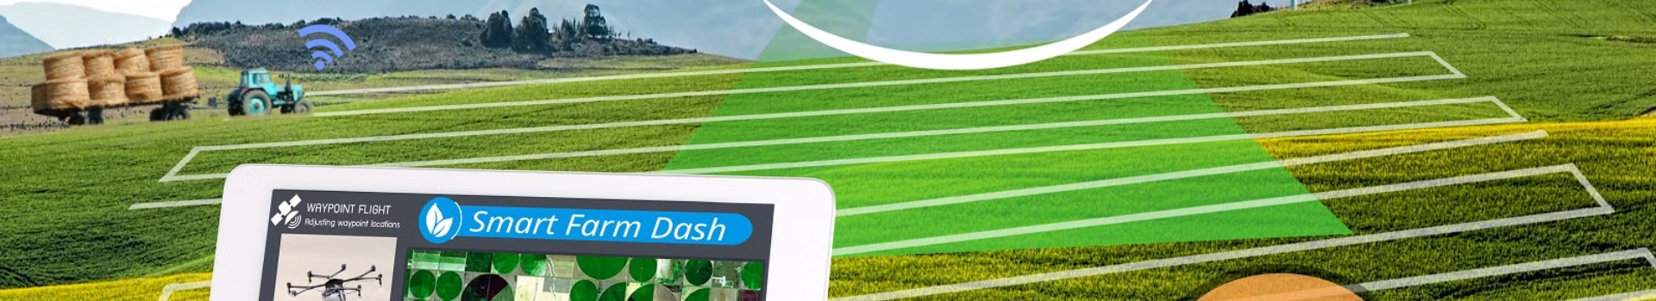
Irrigation and Fertilization Optimization
1
Precision Irrigation
2
Variable Rate Technology
3
Nutrient Monitoring
Smart irrigation controllers adjust water application based on soil moisture and crop needs.
Fertilizer and pesticide application is tailored to specific zones within the field.
Continuous soil and plant analysis ensures the optimal balance of essential nutrients.

Slide 6
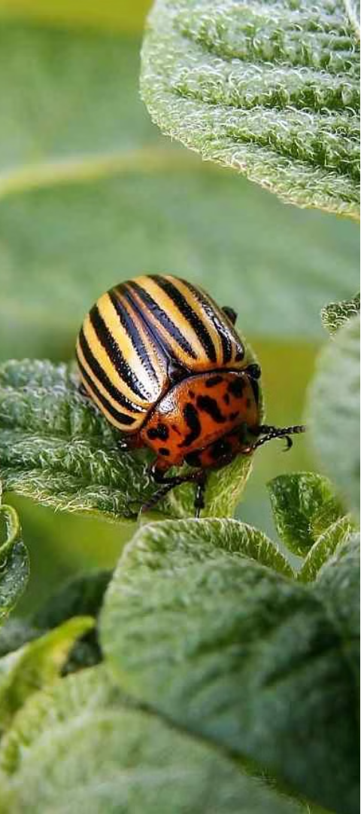
Pest and Disease Management
Early Detection
Predictive Modeling
Computer vision and IoT sensors identify pest infestations and disease symptoms early.
AI algorithms forecast the spread of pests and diseases to enable proactive intervention.
Targeted Treatment
Precision sprayers apply pesticides and fungicides only where and when needed.

Slide 7
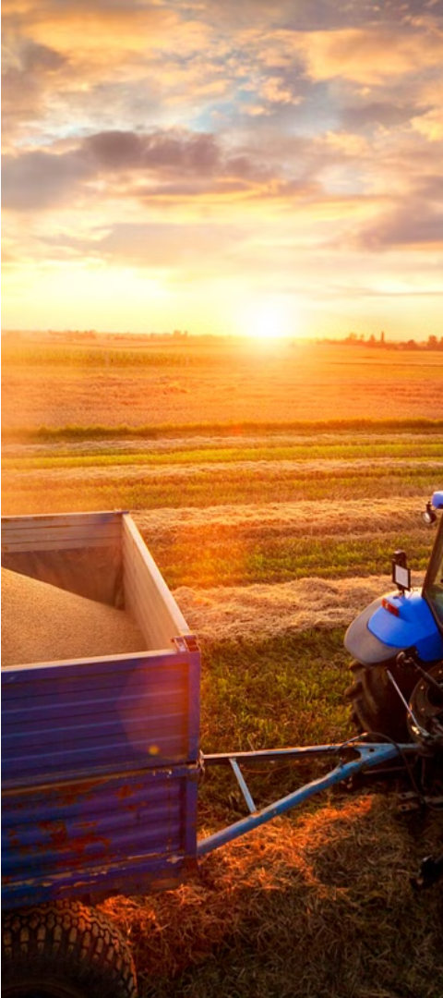



Yield Prediction and Harvest Planning
Yield Forecasting
Advanced analytics combine data from various sources to predict crop yields accurately.
Harvest Optimization
AI-driven planning tools determine the optimal timing and sequence of harvesting.
Post-Harvest Insights
Data-driven analysis of harvest outcomes informs future planning and decision-making.

Slide 8
Conclusion and Benefits
Increased Yields
Reduced Costs
Improved Sustainability
Enhanced Resilience
The smart agriculture decision support system empowers farmers to make more informed, data-driven decisions, leading to higher productivity, lower environmental impact, and greater profitability. This integrated platform revolutionizes modern agriculture, paving the way for a sustainable and prosperous future.

